Slide 1
Student Success with Hawkes Learning
Innovative Educators Summit
March 2, 2019
Ellen Oliver – New River Community College (VA)
Bob Parker – Rappahannock Community College (VA)

Slide 2
Presentation Overview
Background info
Why do we use and like Hawkes?
How we each use Hawkes in our modular developmental math courses
Student Success Strategies:
Smaller class sizes -> more one-on-one assistance
Class management (RCC)
Embedded tutors (NRCC)
Gretchen Rubin’s Four Tendencies (NRCC)
Future possibility: connecting developmental math courses with college success courses (NRCC)
Notes:
Overview - both

Slide 3
Background: VCCS Dev Math Redesign
Around 2009, the Virginia Community College System (VCCS) mandated a redesign of our developmental math curriculum and courses.
Redesign goals:
Reduce the number of students entering developmental math.
Reduce the time needed to complete developmental math.
The curriculum was divided into 9 modules (plus basic skills – “Unit 0”). Specific module contents are on the next slide.
The redesigned courses were implemented in the Spring of 2012
Schools were allowed some autonomy in course delivery, but the content of the 9 modules was consistent, and the modular delivery method was mandated. Each module = 1 credit.
The placement test (VPT) was redesigned at the same time.
Updates to the redesign have been ongoing:
“Multiple Measures” placement.
Creation of co-requisite courses.
Creation of “bundling” options.
Notes:
Leave this in, but don’t spend too much time here?
Bob – we need to discuss the effect multiple measure and co reqs have had on enrollment and the type of student we have in class (Ellen: yes! Perfect.)

Slide 4
VCCS Developmental Math Modules
MTE 1 Operations with Fractions
MTE 2 Operations with Decimals and Percents
MTE 3 Algebra Basics
MTE 4 First-degree Equations and Inequalities
MTE 5 Linear Equations, Systems of Linear Equations
MTE 6 Exponents, Factoring, Polynomial Equations
MTE 7 Rational Expressions and Equations
MTE 8 Rational Exponents and Radicals
MTE 9 Functions, Quadratic Equations and Parabolas
Each module takes about 40 hours to complete, on average, so time management becomes a very big issue for these courses.
Notes:
Our audience is dev-ed instructors, so they might be curious about how we break the material up. We don’t need to spend much time on this slide though.

Slide 5
Background: Our Schools
New River CC – Dublin, VA - rural
Head count (2017-2018): 6402
Annualized FTE – (2017-2018): 2792
# of Developmental Sections: Fall 2018 = 13, Spring 2019 = 9 (this has decreased from last year)
Average class size around 10 – 20 (this has decreased from last year)
Lab setting, with embedded tutor/lab assistant + 1 instructor
Rappahannock CC –Glenns and Warsaw, VA
Head count (2017-2018): 4321
Annualized FTE – (2017-2018): 1838
# of Developmental Sections: Fall 2016 = 14, Fall 2018 = 8
Maximum class size 28, average in class size around 15, online around 25
Notes:
Don’t spend too much time on this…

Slide 6
VCCS Developmental Math Course Design
Using “multiple measures”, students either place out of developmental math, or must take the VPT-Math (Virginia Placement Test – Math)
VPT results indicate which modules a student has passed and which may still be needed, depending on credit math course needed (based on program of study).
Modules, and material within the modules, must be completed sequentially, but students only complete modules they need based on VPT results.
Hawkes Learning created a course to match the VCCS developmental math curriculum: Foundations of Math for Virginia. There have been three iterations so far of our “Guided Notebook” (most recent version was created in collaboration with Germanna CC faculty).
Students work in a math lab setting.
Teachers may conduct “mini-lectures” as needed.
“Lecture sections” may be offered depending on enrollment.
Notes:
Notes from last year:
I’d like to go through this slide and the next one pretty quickly if we can, since how we use the software, and student success strategies, is our focus.
“Math Lab Setting” = self-paced, working at their computers – watch videos, read the e-text, take notes, work practice problems, and demonstrate mastery. Teachers and/or tutors circulate and assist students as needed/requested, with additional individualized intervention by teachers. Students are all working on different modules, but are often seated near others working in the same module.
Specific differences between our two colleges are on the next slide.

Slide 7
Differences between NRCC and RCC
New River CC (Ellen)
Rappahannock CC (Bob)
Guided self-paced classroom
“To-Do List” in Hawkes broken down by weeks to help students stay on track
Students register for 1, 2, or 3 Units depending on what they need for their program
Students must complete each Unit in 5 weeks or restart it from the beginning (~8 hours/week)
Passed Units are retained; partial Units must be restarted next semester
Self-paced classroom
Students register for how many modules they wish to complete and their program requirements
Students have entire semester to complete their modules
Student work retained semester to semester
Notes:
Ellen: minor edits made to reflect current practices

Slide 8
Why do we use and like Hawkes?
Reliability & Customer Service
Almost no outages
Quick, reliable, easy customer service experiences
Cost/Lifetime Access
Less expensive for students
Offers lifetime access
Built-In Support/Customizable
Automatic reminder emails (optional and customizable)
To-Do List (customizable)
E-text is customizable
Ability to add notes documents, links, other assessments (Guided Notebook Check), etc.
The error feedback is “smart” – different based on which error(s) student made
Streamlined and Mastery-Based Curriculum
Hawkes custom-designed course to match VCCS modules
Learn/Practice/Certify
Guided Notebook – created for us, and updated three times so far, with input from instructors
Prescriptive Pre-Test
Notes:
Our audience is about 50-50 of those already using Hawkes and those considering it. I don’t think we need to spend tons of time on this, but those who are considering it would likely appreciate this part of our presentation.
For “customizable”, include that I have different settings for my F2F and DE sections, and you can change settings by student, by section, or by assessment as well.

Slide 9
What do our courses look like in Hawkes?
Learn.HawkesLearning.com
Notes:
Ellen’s student log-in info: eoliver@nr.edu (NRCCis#1)
Not a lot to see on Bob’s that is different.
Show Learn -> Practice -> Certify learning path.
Can demo how Ellen’s students create account (last 7 slides) at the end of the presentation if desired and there’s time.

Slide 10
Student Success Focus: Smaller Class Sizes
Silver lining! Drops in enrollment numbers mean fewer sections, but smaller class sizes, so more individual attention is possible.
Instructor moves around the room, sitting with each student individually at least once per class period, working individually with that student and discussing their progress in the course.
Also leaves time for building individual relationships with each student, hopefully leading to more buy-in from them, and trust between student and instructor.

Slide 11
Student Success Focus: Class Management strategies at RCC
First day expectations
Muddiest point sheets
Celebrating Successes
Teachers role in a lab setting
Notes:
Bob: These are mine, we can add anything you have

Slide 12
Student Success Focus: Embedded Tutors (NRCC)
Each class either has an embedded tutor or a math-lab assistant who is present at each class.
Tutors are staffed and paid for by Academic Assistance (NRCC’s tutoring center).
Tutors are trained by Academic Assistance, mentor tutors, and classroom instructor as to how best to help developmental math students.
Some are better than others, but they tend to build a different relationship with the students and provide them an option if they feel less comfortable with the instructor.
They may be NRCC students, or nearby 4-year students, or adults in the community.

Slide 13
Student Success Focus: The Four Tendencies
Based on The Four Tendencies by Gretchen Rubin
The Four Tendencies:
“Obliger”: meets outer expectations; resists inner expectations
“Upholder”: meets outer expectations; meets inner expectations
“Questioner”: resists outer expectations; meets inner expectations
“Rebel”: resists outer expectations; resists inner expectations
Encourage students to take the online quiz.
Share strategies to help them be successful in this course (and in school in general) based on their tendency.
Notes:
Ellen

Slide 14
Student Success Focus: FUTURE IDEA
NRCC is contemplating creating a “seminar” course that would connect a developmental math course with our College Success Skills course, especially in the Fall semester.
Would create a cohort, and the ability to offer support and guidance across several domains at once.
Could be taught by the same instructor, or team taught.
Does anyone have experience with something like this they’d like to share?

Slide 15
Questions? And Thank You!
Ellen Oliver eoliver@nr.edu
Bob Parker rparker@rappahannock.edu

Slide 16
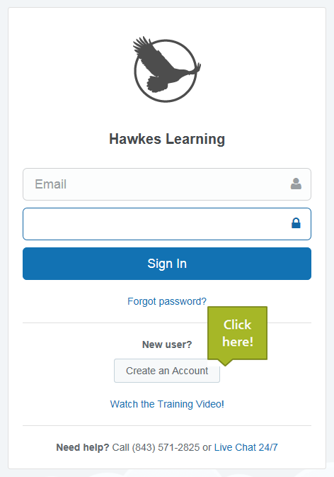
Learn.HawkesLearning.com (New Students)
If you are a new MTT student, the next few slides will walk you through creating your account. Go to the above web site.
Click on Create an Account.
Notes:
We can fly through these really quickly.

Slide 17
Step 1: Enter your access code or license number.
If you have already purchased your materials for this course, enter your license number.
If you have not yet purchased your book for this class, click on “I want to request Temporary Access” and then click “Continue”. The temporary access code is good for 20 days from the start of the semester. When the time is up, you will be asked to enter a valid access code, so please purchase your code and Guided Notebook from the bookstore as soon as possible.
You will then be led through the account creation process. You must use your VCCS email address to create your account.

Slide 18
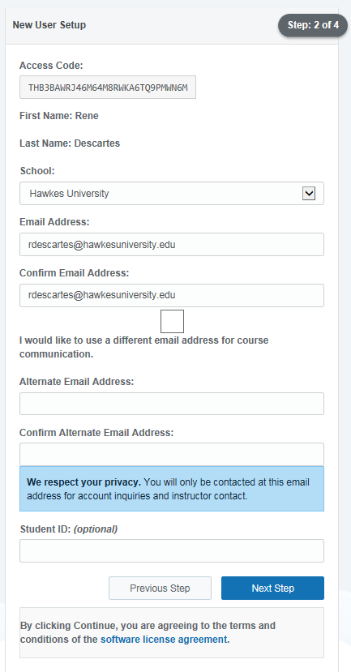
Step 2: Enter your contact information
Make sure to enter your VCCS email address!
Enter an alternate email address for message forwarding if preferred. (But remember that you must always use your VCCS email address when communicating with your instructors.)

Slide 19
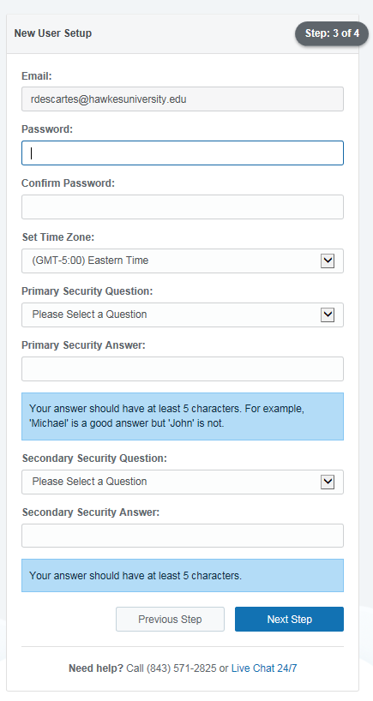
Step 3: Provide security information
Your password must include one letter, one number and at least 6 characters.
Security question/answers need at least 5 characters.

Slide 20
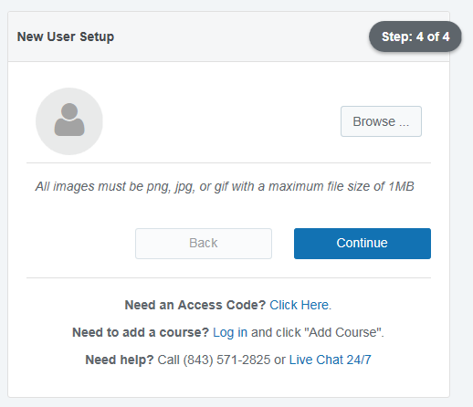
Step 4: If you want, add an optional profile picture

Slide 21
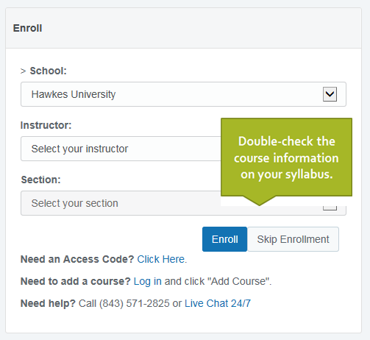
Step 5: Select your instructor first, then choose the section for the first Unit you will be completing this semester (see your Pacing Guide).

Slide 22
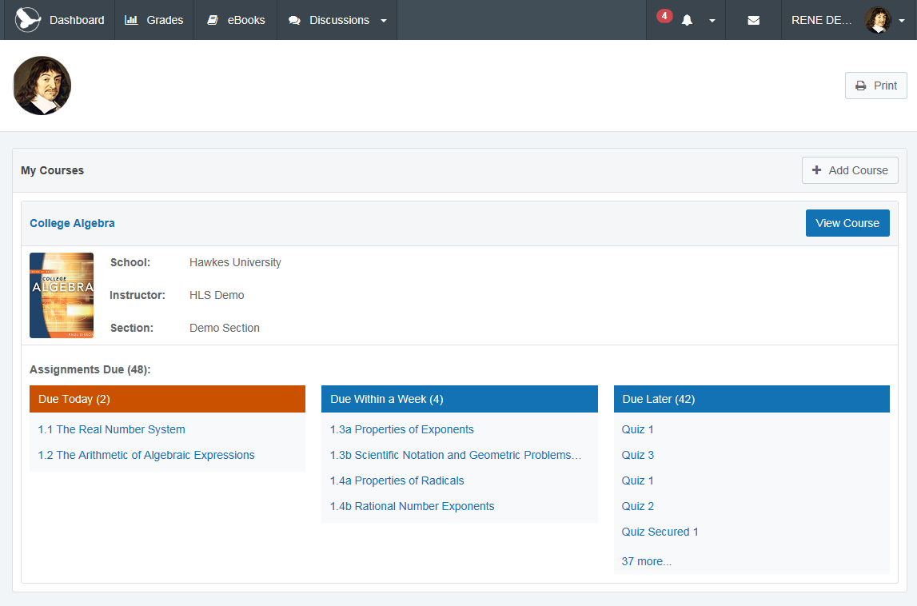
You’re ready to get started!

